Slide 1
Automatic KY guardrail detection by machine learning
KTC / VIS

Slide 2
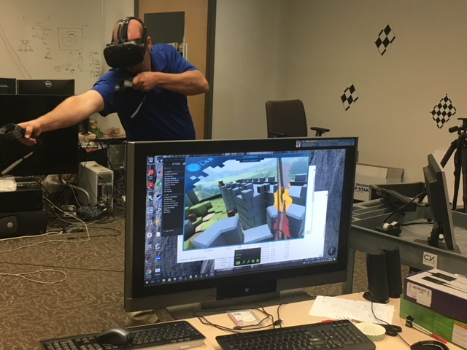
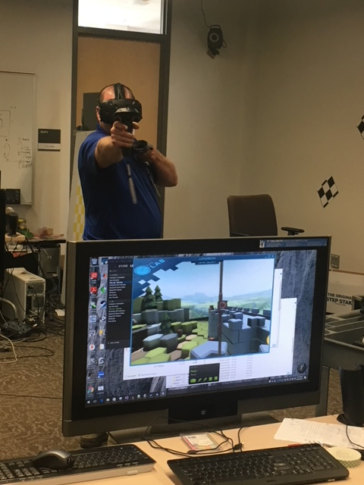

Slide 3
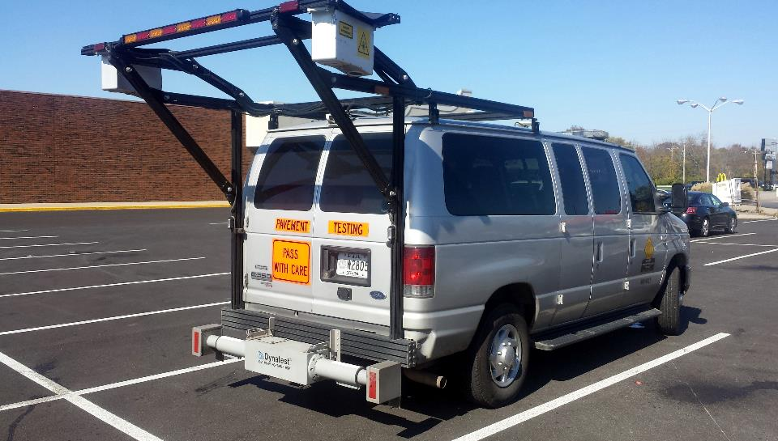
KYTC Photo logging van
The Kentucky Transportation operates a fleet of three asset collection vehicles. Automated data collection is conducted annually on the Interstate and NHS routes, and on a two year cycle for all non-NHS routes. Average yearly collection is 35,000 lane miles. This data collection includes automated pavement distress, rutting, cross slope, IRI, faulting, curve & grade, GPS data, and roadway images. In addition to network testing, the KYTC also performs IRI acceptance testing for new construction.

Slide 4
Train prediction model with CNN (Convolutional Neural Network)
Hao Zhu

Slide 5
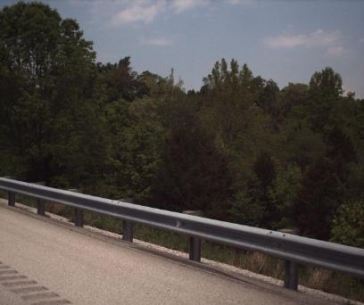
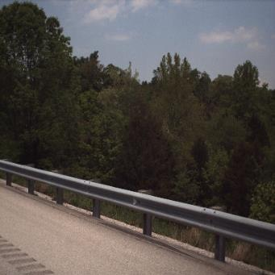
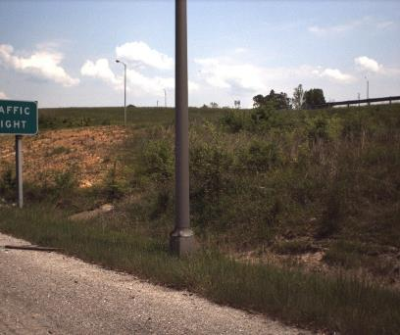
Data Preprocessing
Original Image
Resize
Label
Mask
True
False

Slide 6
Data Preprocessing
randomly select 10, 000 images and label them
7, 000 images for training
3, 000 images for validation

Slide 7
Label Prediction Model
Softmax
Loss
False
True
result
2 FC/DO layer
data input
6 Conv/ReLu layer

Slide 8
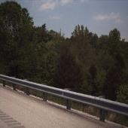
Mask Predicting Model (Work in Progress)
result
Softmax Loss
data input
6 Conv/Relu layer
4 FC/DO layer
6 Deconv/Relu layer

Slide 9
Prediction result
 | Number | Rate
Overall | 3000 | 100%
Correct | 2939 | 98.0%
Error | 61 | 2.03%
False Negative | 33 | 1.10%
False Positive | 28 | 0.933%

Slide 10
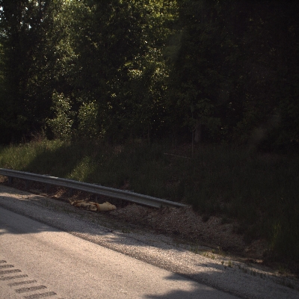
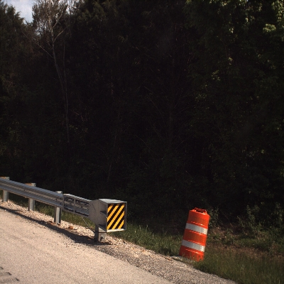
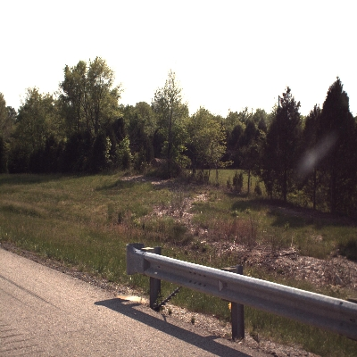
Failure Case
Case 1: partial guard rail exists
probability of occurrence: 13/61= 21.3%
Probability = 0.020
Probability = 0.140
Probability = 0.254
Note: Value 1 means guard rail, value 0 means no guard rail.

Slide 11
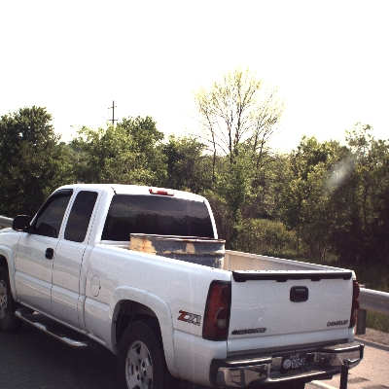
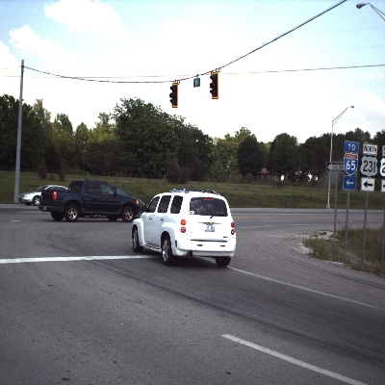
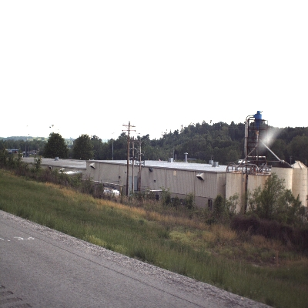
Failure Case
Case 2: affected by construction or car
probability of occurrence: 13/61= 21.3%
Probability = 0.988
Probability = 0.824
Probability = 0.900
Note: Value 1 means guard rail, value 0 means no guard rail.

Slide 12
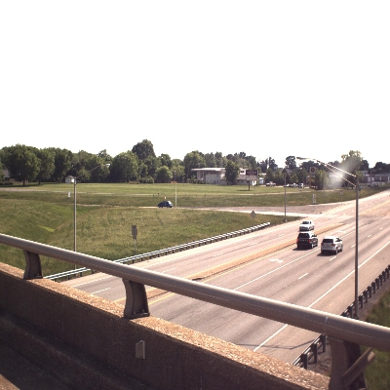
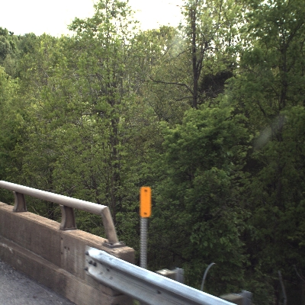
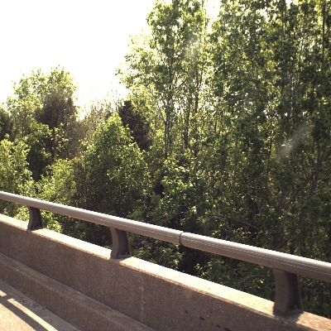
Failure Case
Case 3: mistaken with stone guard rail
probability of occurrence: 21/61= 34.4%
Probability = 0.999
Probability = 0.082
Probability = 0.602
Note: Value 1 means guard rail, value 0 means no guard rail.

Slide 13
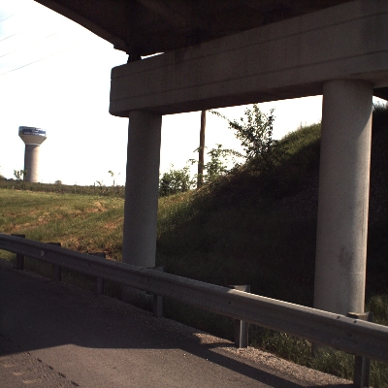
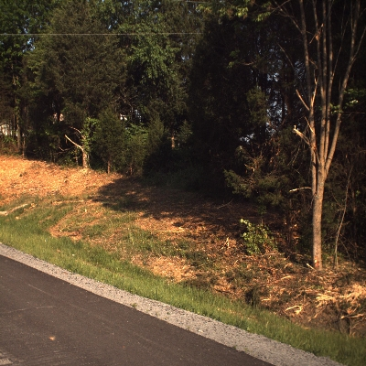
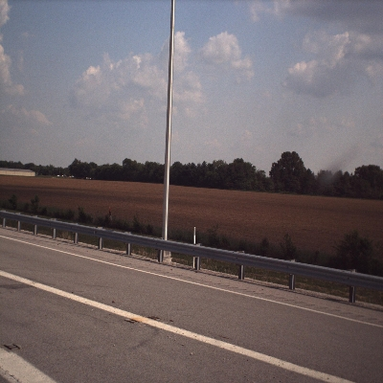
Failure Case
Case 4: complex or unfamiliar environment
probability of occurrence: 14/61= 23.0%
large shadow region
exists analogous cobbled road
too far from guard rail
Probability = 0.425
Probability = 0.730
Probability = 0.359
Note: Value 1 means guard rail, value 0 means no guard rail.

Slide 14
Mask Predicting Result
Accuracy | Number | Rate
>90% | 2062 | 68.7%
50% - 90% | 227 | 7.57%
< 50% | 711 | 23.7%

Slide 15
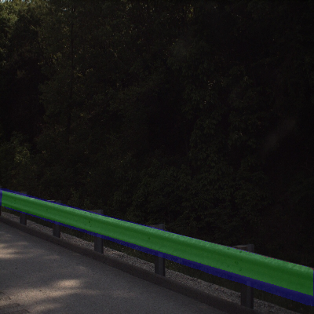
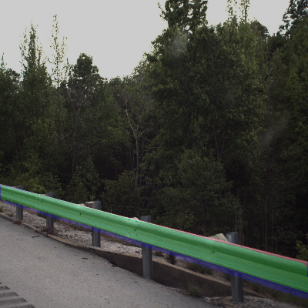
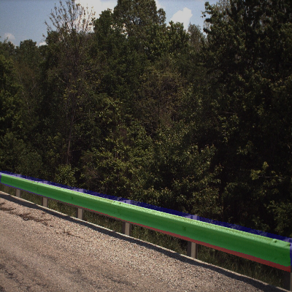
Correct Case
Note: green – match region; red: missing region; blue: redundant region

Slide 16
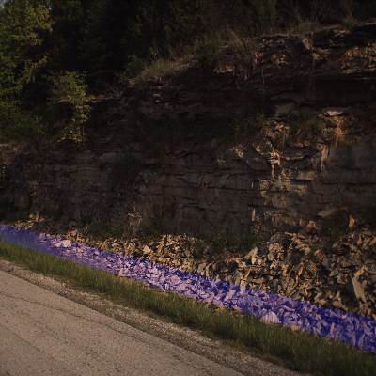
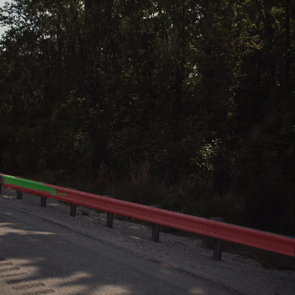
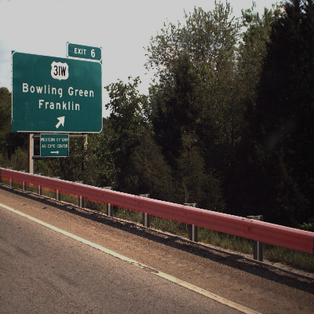
Failure Case
Note: green – match region; red: missing region; blue: redundant region

Slide 17
Post-processing Framework with trained model and ArcGIS
Yongwook Song

Slide 18
Post-Processing framework
Video Log CSV file
(GPS / Image URL)
Download Image
ArcGIS Python Library
Chance of having guardrail (0 ~ 1)
Create Feature
Get information (GPS and etc.)
Upload to ArcGIS

Slide 19
Predict label with trained model for each image in input CSV file
Input CSV file
1: Image URL, Road name …
Python code
1: Label prediction (0 ~ 1)
Download each image by using given URL
Pre-processing (resizing)
Error checking
Predict label with previously trained model
Prediction result is value from 0 to 1
Higher value means input image has higher chance of having guardrail
2: Image URL, Road name …
2: Label prediction (0 ~ 1)
3: Image URL, Road name …
3: Label prediction (0 ~ 1)
4: Image URL, Road name …
4: Label prediction (0 ~ 1)
………….
………….
1: Image URL, Road name, Label prediction …
2: Image URL, Road name, Label prediction …
3: Image URL, Road name, Label prediction …
Combine input CVS with
label prediction value
………….
Post-processed CSV file

Slide 20
Predict guardrail lines and upload to ArcGIS
Post-processed CSV file
1: Image URL, Road name, Label prediction …
Python code
Upload to ArcGIS webmap
Sort records based on road name and sequence number
Use label prediction values after sorting to create polyline that has continuous label prediction values higher than threshold
Use ArcGIS python library to connect database and upload polyline feature to database
2: Image URL, Road name, Label prediction …
3: Image URL, Road name, Label prediction …
4: Image URL, Road name, Label prediction …
………….

Slide 21
ArcGIS featuremap Example
Eileen Grady / Brad Rister

Slide 22
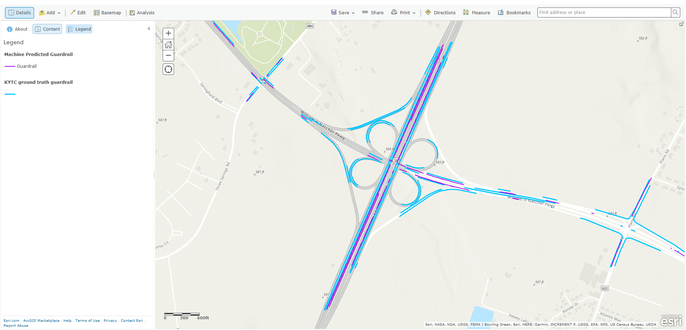
Notes:
Screenshot of guardrail mapped by computer (purple), and guardrail as mapped on the ground by KYTC personnel (blue).

Slide 23
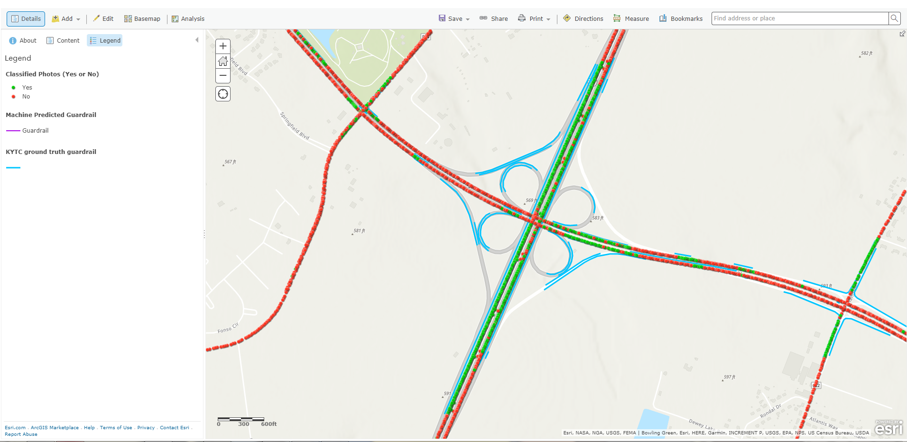
Notes:
Shows that computer does not fail to map guardrail on these ramps because of inaccuracy, but because there are no photos to classify.

Slide 24
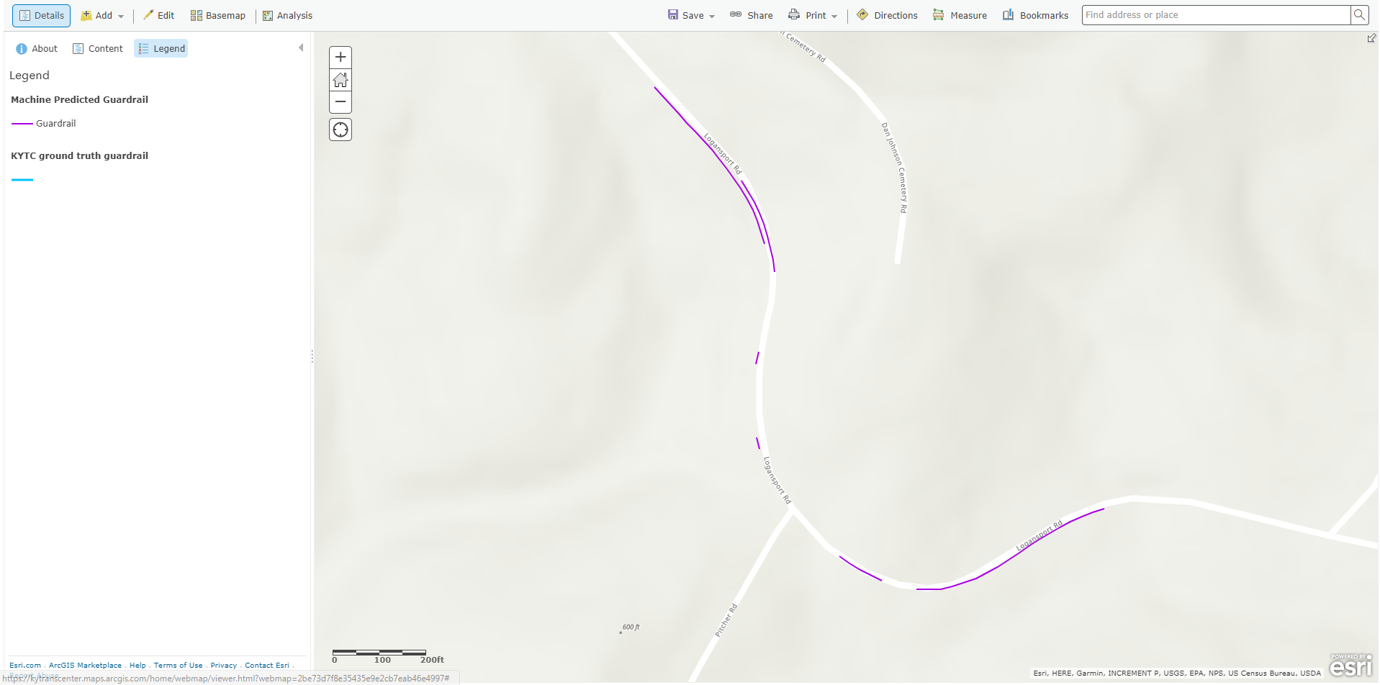
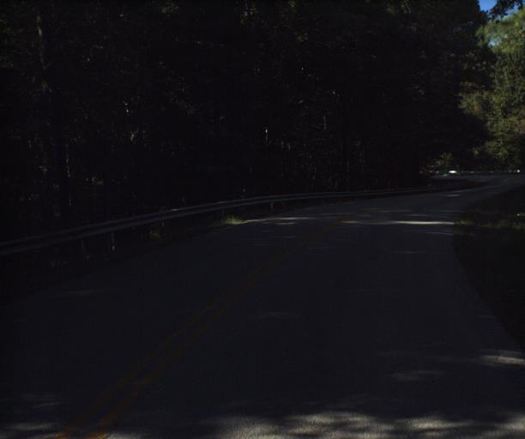
Notes:
KYTC personnel has not mapped guardrail here yet, but the computer correctly detected guardrail. However, the computer did not map guardrail consistently along this road because of poor photo quality.

Slide 25
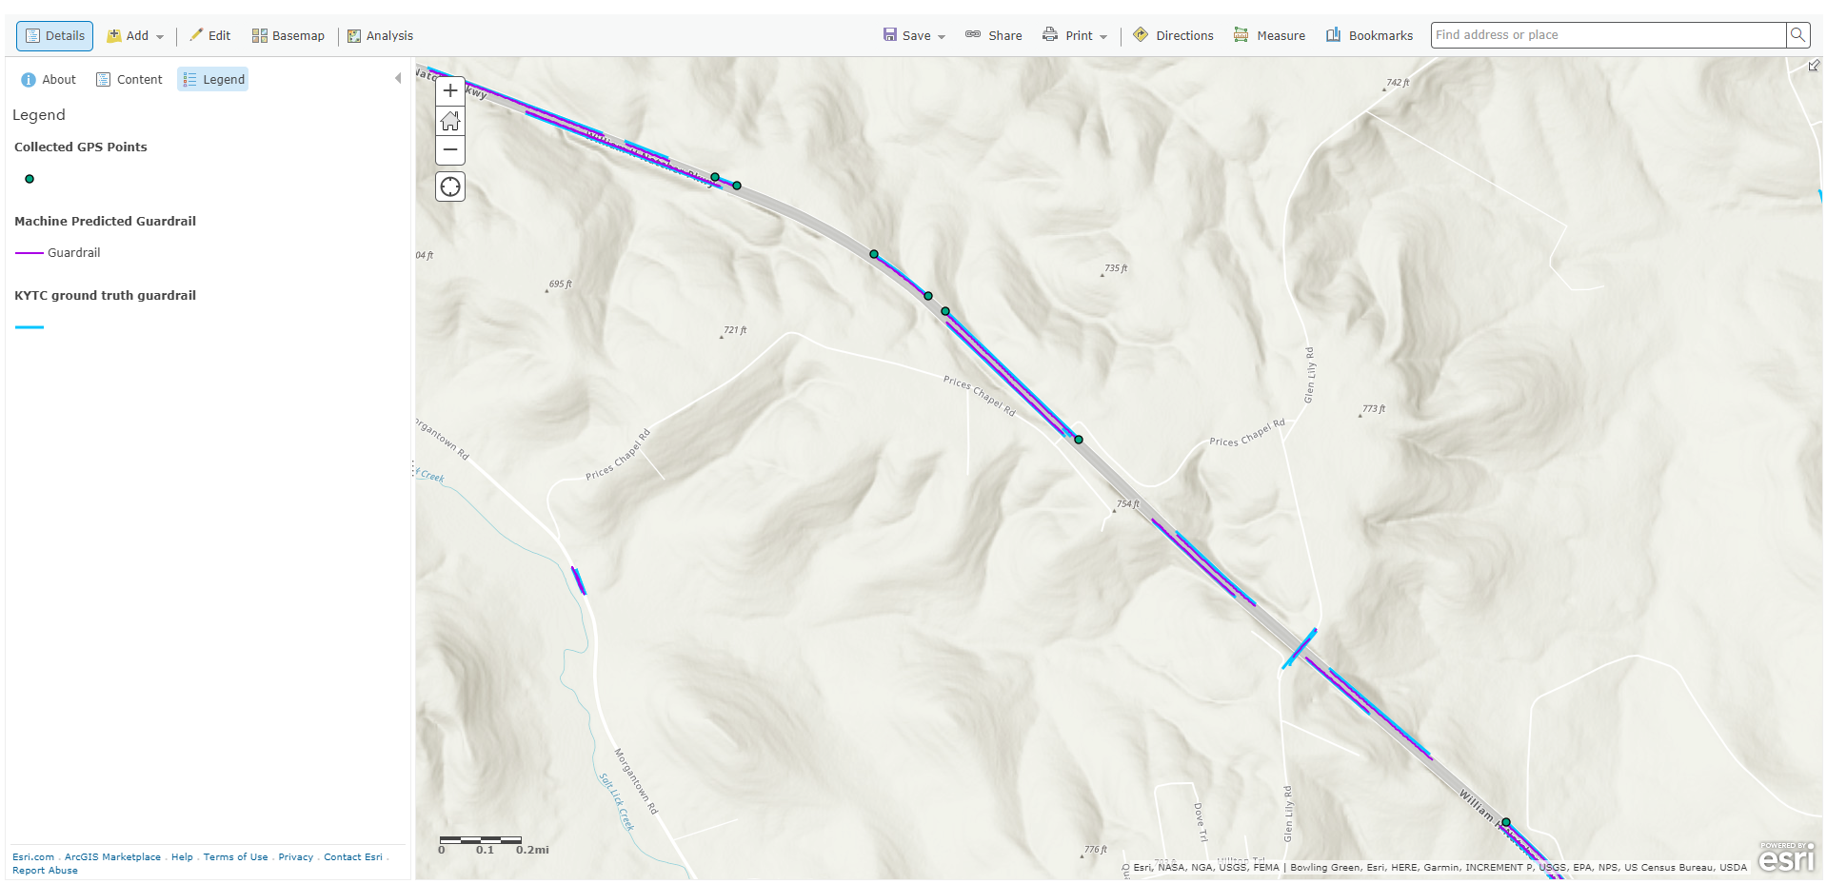
Notes:
Shows GPS points mapped on the ground, using a Trimble GeoExplorer 6000 and TerraSync Software. Corrected in real time using KYCORS network to attain sub-foot accuracy. Lines in blue mapped by KYTC personnel using Esri Collector deployed on iOS devices, via windshield survey. Esri Collector accuracy varies. Machine learning maps using lat/long coordinates obtained from photos.

Slide 26
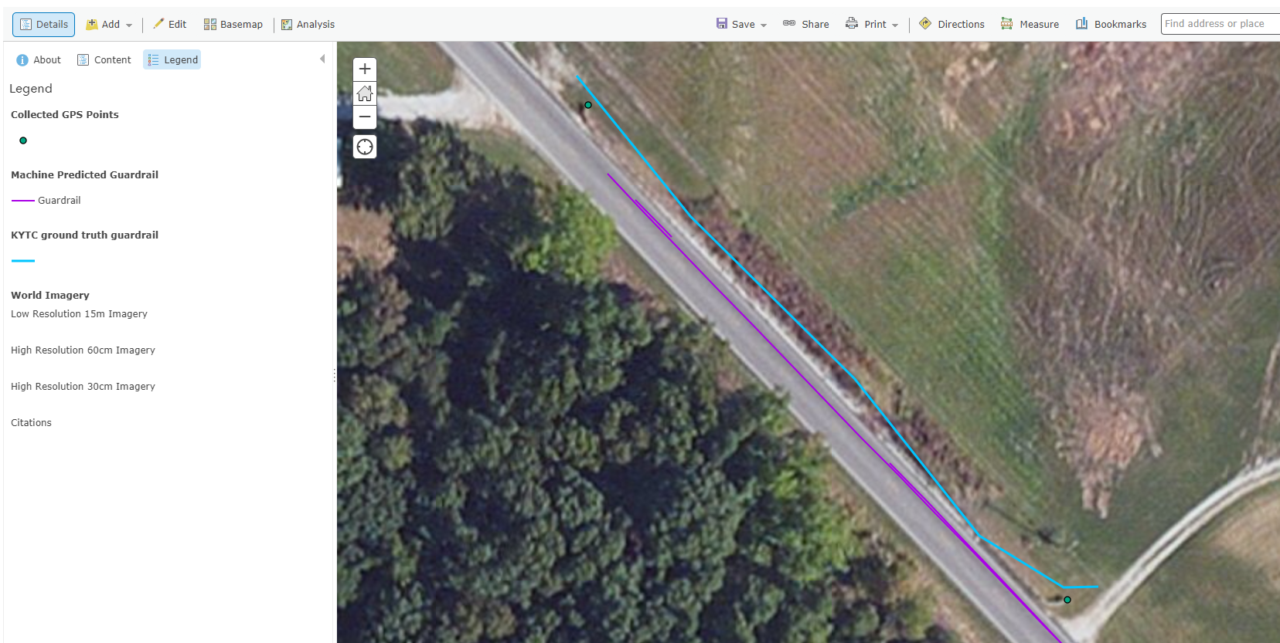
https://kytranscenter.maps.arcgis.com/home/webmap/viewer.html?webmap=2be73d7f8e35435e9e2cb7eab46e4997
Notes:
Can see the GPS points mapped right on top of the starting and ending points of the guardrail in the aerial imagery.

Slide 27
Possible future of collection in real time
https://youtu.be/S33BNcnlxdU

